Slide 1
CS 4530: Fundamentals of Software Engineering
Module 3.2: Code Coverage & Mutation Testing
Adeel Bhutta, Rob Simmons, and Mitch Wand
Khoury College of Computer Sciences
© 2026 Released under the CC BY-SA license

Slide 2
Learning Goals for this Lesson
At the end of this lesson, you should be able to
  Explain what code coverage is, and how different measures differ, including statements, branches, functions, and lines
  Explain the benefits of mutation testing

Slide 3
When have I written enough tests?
Notes:
Returning to the key question: when have we written enough tests.
Well, why do we write tests in the first place? That might help us know when we’re done.

Slide 4
Why do we test?
Test Driven Development
  If we start with tests, passing the tests lets us know we’re done meeting the conditions of satisfaction
Acceptance Testing
  Does the customer agree we’ve met the conditions of satisfaction?
Regression Testing
  Did something change since some previous version?
  Prevent bugs from (re-)entering during maintenance.
  “Good” test suite detects bugs that (inevitably) get added as software is developed over time: tests are for the future
Notes:
Our focus in the last lecture was on testing as part of the test-driven development process: testing is so we know when we’re done building the thing we’re building. That’s still true, but there are some other important considerations worth mentioning.
Software engineering is about developing software for people in groups over time. The assumption behind test-driven specification is that the real specification is often not written out explicitly or precisely, so often the tests are the most effective documentation of that unwritten spec, and that documentation may be all that anyone remembers when it matters.
You may have specific domain knowledge that future developers who touch the code do not (or that you will forget)
This leads to the Beyonce rule: "if you liked it you should have put a test on it". This rule recognizes that often the tests *are* the specification.

Slide 5
Code Coverage
The industry standard answer for “have I written enough tests”
Measures “how much of your code” is exercised by your tests
If none of your test even execute a piece of code, it’s not being tested!
Notes:
That talks about what our goals are for writing enough tests. In most software engineering applications, when we measure whether we’re writing good tests, we are talking about measuring code coverage.
Measuring code coverage is based on a really simple thought: if you’re not running code, you’re not testing it.

Slide 6
Code Coverage: Line or Statement Coverage
Line and Statement coverage: coarsest measure.
Testing x = 0 exercises lines 1 and 2
Testing x = 10 exercises lines 1, 4, 5, and 6.
1| if (x === 0) {
2| return 3;
3| }
4| const y = x > 4 ? 2 : 3;
5| const z = x % 2 == 0 ? 1 : 2;
6| return x / (y - z);

Slide 7
Code Coverage: Branch Coverage
Branch coverage: most widely used in industry.
Testing with x > 4 and x <= 4 necessary to handle both branches on line 4.
Testing with odd and even numbers necessary to handle both branches on line 5.
The values -2, 0, 1, and 10 get full branch coverage.
1| if (x === 0) {
2| return 3;
3| }
4| const y = x > 4 ? 2 : 3;
5| const z = x % 2 == 0 ? 1 : 2;
6| return x / (y - z);

Slide 8
Code Coverage: Path Coverage
The values -2, 0, 1, and 10 get full branch coverage…
…but 5 causes line 6 to divide by zero!
  In JavaScript/TypeScript, this doesn’t cause an exception, there’s a number called “NaN” for “not a number”
Path coverage covers all combinations of branches; it is infeasible in practice.
1| if (x === 0) {
2| return 3;
3| }
4| const y = x > 4 ? 2 : 3;
5| const z = x % 2 == 0 ? 1 : 2;
6| return x / (y - z);

Slide 9
Code Coverage: Example
What tests will get line/branch/path coverage here?
/**
* Prints "hello" repeatedly
*
* @param numHellos - number of times to print “hello”,
* must be an integer >= 0
*/
function helloNTimes(numHellos: number) {
for (let i = numHellos; i !== 0; i--) {
console.log('hello');
}
}
Notes:
(Answer: just the input 1 will get line coverage and branch coverage. That’s not great! But path coverage would take an infinite number of tests. This metric isn’t perfect!)

Slide 10
Code Coverage: Example 2
What tests will get line/branch/path coverage here?
type zAuth = z.object({ username: z.string(), password: z.string() })
function useAuth(x: unknown) {
const auth = zAuth.safeParse(x);
if (!auth.error) {
// write the code you care about here!
}
}
Notes:
When we take an unknown input and validate it, that puts a branch in our code, and so branch coverage obligates us to write tests that pass and fail authentication.

Slide 11
Code Coverage: More Examples
Some of our intuition about “edge cases” can be understood in terms of trying to imagine inputs that will provide code coverage for an unknown function.
  BUT: code coverage won’t tell you to check 0 specifically if there’s a branch that checks x >= 0
  Thinking about the “edge case” of a branch is a good move
What inputs should we start with if:
  We’re taking numbers that are supposed to represent a 5-digit zip code?
  We’re taking strings that are supposed to represent a 5-digit zip code?
  We’re taking an array of strings that represent people’s names?
Notes:
Possible answers:
numbers too large or small to be zip codes, zip codes that start with one or more zeros
Strings too short or two long to be a 5-digit zip code, 5-digit numbers that are and are not valid zip codes, 5-character strings that aren’t all digits
Arrays that are empty, that contain duplicate names, that contain all unique names, that are sorted or not

Slide 12

Code Coverage in Vitest
Tools like vitest makes it easy to check code coverage

Slide 13
Code Coverage: Review
Total code coverage — by any metric — does not mean no bugs
  Running code doesn’t mean checking that it’s doing the right thing! (important to Assemble/Act/Assess)
Coverage checking can be invaluable at identifying when you think you’re testing something but you’re not, which is a real problem in practice.
  Test-Driven Development also valuable for this problem: it’s important that tests switch from failing to succeeding when you expect them to
Notes:
(Rob: I’ve been saved more than once by trying to intentionally break my code and noticing that the test I expected to fail didn’t fail — this meant the test wasn’t checking what I expected it to!)

Slide 14
Adversarial Testing
It can be helpful to think of testing as a game in which you play against an adversary.
Your adversary plays by producing multiple versions of code that you agree is buggy, and multiple versions of code you agree is correct.
Your win if your tests catch all the buggy code,
and pass all the correct code.
Notes:
When we need a graph to measure “have we written enough tests,” code coverage is absolutely what everyone uses. But we’ve just seen a couple of ways that this can fail to tell us that we’ve written enough tests — or at least, fail to tell us when our tests are any good.
A much more robust way to think about the question of have I written enough tests is the idea of adversarial testing. Could someone else write a buggy version of your code that your tests would fail to catch?

Slide 15

Adversarial Testing
Original code (correct)
// find the first item in the list that is
// greater than or equal to the target.
export default function search(list:number[], target:number) {
return list.find((item) => item >= target);
}
Mutated code (buggy)
// find the first item in the list that is
// greater than or equal to the target.
export default function search(list:number[], target:number) {
return list.find((item) => item > target);
}
Notes:
Here’s an example of a function that has an error that you might make if you were in a hurry, or tired, or it was late at night.
Snidely Whiplash (over there on the right) asks "can your tests tell that something went wrong"?
Q: can think of a test that would catch the error (search([1,2,3],2) — will return 3 instead of 2)
Q: can you think of a test that would fail to catch the error (search([1,2,5], 3) — will correctly return 5)
Would the failing test ace our code coverage tests (yes!)

Slide 16
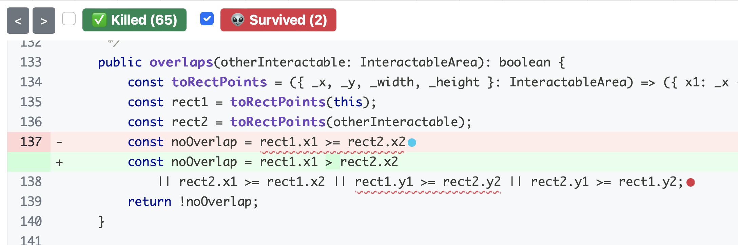
Adversarial Testing
Stryker is a mutation tester for JavaScript — an automated adversary!
Notes:
The idea of "mutation testing" is that most defects are the result of simple errors. (Is this a realistic assumption? Spoiler alert: it's realistic enough!)
In mutation testing, the adversary generates buggy code by making simple changes. Generating buggy code in this way is clearly automatable.

Slide 17
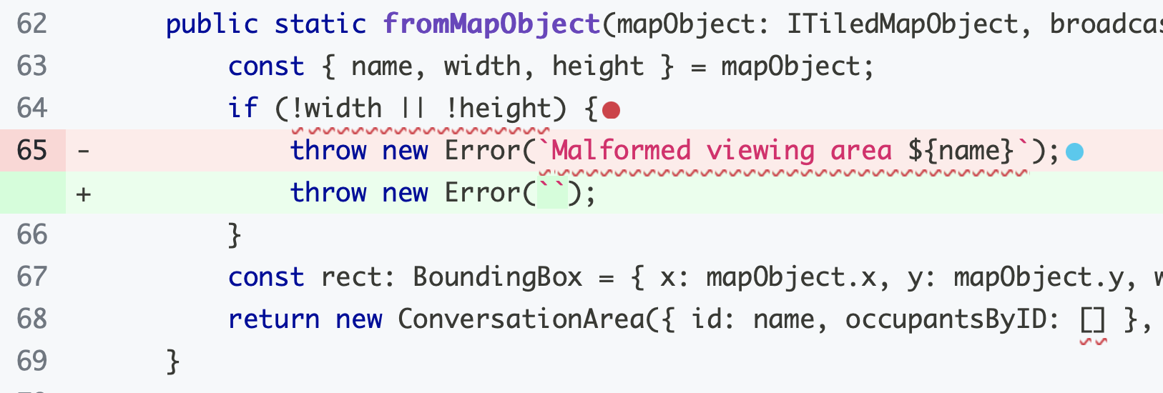
Adversarial Testing and Overspecification
Stryker is a mutation tester for JavaScript — an automated adversary!
Sometimes it loses the game because mutants aren’t bugs.
Notes:
Adversarial testing is a game, and sometimes your adversary loses the game because the “mutant” isn’t a bug.
If the spec is just “throw an error if the width or height is nonzero” then this change is fine.
This is related to a real problem with tests: they can be overspecified, and can test properties of your program you don’t actually care about. In the Tic-Tac-Toe example in your homework, the tests have to be carefully written, because it doesn’t matter whether you describe a winning line as ([[0,0], [1,1], [2,2]]) or ([[1,1], [0,0], [2,2]]).
Overly-specific tests aren’t generally a huge problem, but they can lead to flaky tests — imagine a tic-tac-toe program has randomness, and some of the time it reports solutions in a different order, so your fail… some of the time. (We’ll return to this idea in a later lecture.)

Slide 18

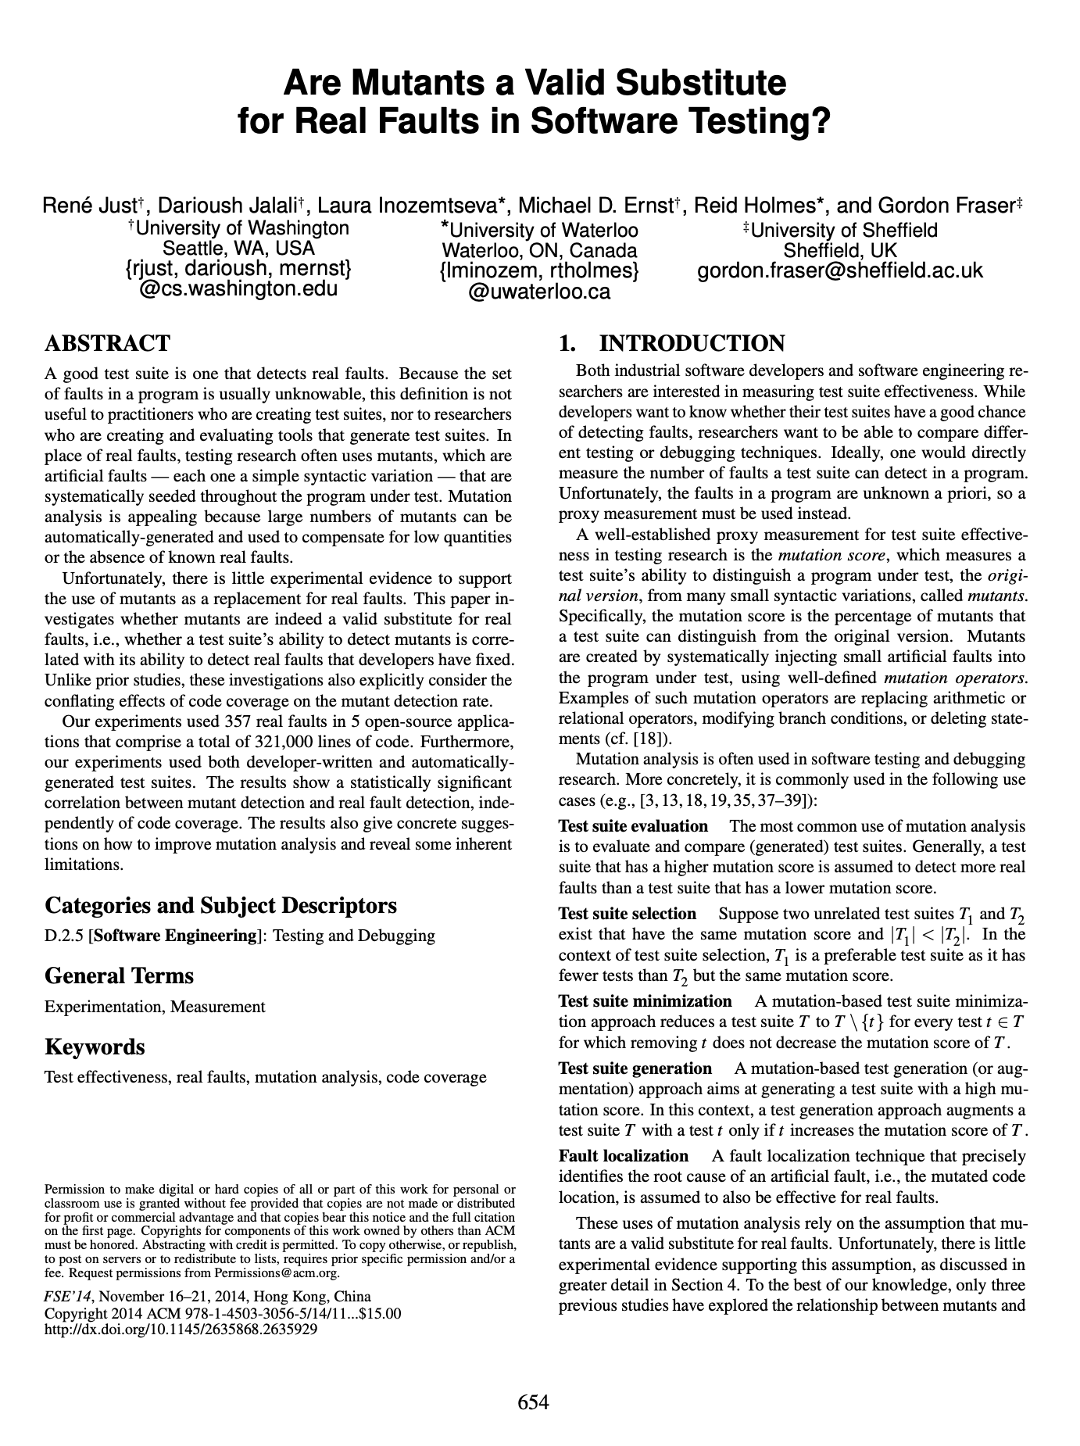
Are mutants a Valid Substitute for Real Faults? Probably yes.
Do mutants really represent real bugs?
Researchers have studied the question of whether a test suite that finds more mutants also finds more real faults
Conclusion: For the 357 real faults studied, yes
This work has been replicated in many other contexts, including with real faults from student code
Notes:
You might look at these mutants, which are caused by such simple operations, and wonder: but do these one-line mutations really represent the kinds of bugs that occur in real software? Because ultimately, that is what we are looking to evaluate, right? Do our tests find real bugs?
This study (and others that have replicated it) is important because it shows that this process of enhancing a test suite to detect more mutants might be worth the effort, because there is empirical evidence that: given two test suites, where one detects more mutants than the other (on the same SUT — System Under Test), the one that detects more mutants also finds more real bugs.

Slide 19
Review
It’s the end of the lesson, so you should be able to
  Explain what code coverage is, and how different measures differ, including statements, branches, functions, and lines
  Explain the benefits of mutation testing
When have you written enough tests?
  When you’ve given representatives of all valid inputs?
  When your tests get full code coverage?
  When your tests can catch any buggy mutant code?
  The answer depends!
Notes:
When have you written enough tests?
If you’re trying to make a graph or report progress to your boss — if you have tests that Assemble/Act/Assess and have 100% branch coverage, you’ve written enough tests.
If you really care about tests that do a good job making sure your code is correct, now and in the future: if your tests will always win the “game” of adversarial testing and find a bug in any buggy implementation.

